Slide 1
UNICEF Club-10/29/18
OFFICERS: SHREYA SHETE, ESHA MANOJ, BEN JAMISON, DANIEL TUAN, XENIA MERCHAN, SMRITHI CHAKRAVARTHY. IMAAN SHANAVAS

Slide 2
Collect your Trick or Treat for UNICEF Boxes Today!! Don’t forget to bring them back at our next meeting: Monday, November 5th

Slide 3
Chipotle Fundraiser
When?
Sunday, November 18th
5 PM-9 PM
Where
Germantown
Address:
19881 Century Blvd, Germantown, MD 20874

Slide 4
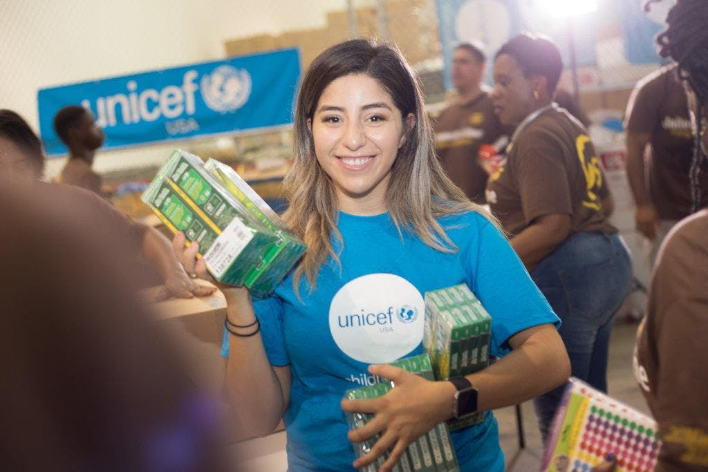
UNICEF Fall forum 2018
Date: November 3, 2018
Time: 10 AM to 3 PM
Location: Georgetown University, Reiss 103 Building
Registration is open to UNICEF Club members and advisors, prospective UNICEF Club members, UNICEF Club Alumni, advocates, community leaders, changemakers and students 13 years old or older interested in global citizenship, international issues, and activism on campus and in their community.
Please register early as registration is expected to reach full capacity.
Register by October 31th 2018 and enter a raffle to win FREE ADMISSION to the UNICEF Annual Summit March 16-19 2019. RSVP HERE

Slide 5
UNICEF USA Fall Forum 2018
The event aims to:
1. Explore the intersection of youth mobilization and issues affecting refugee women and children including gender-based violence, access to education and child protection
2. Learn from a panel of leading experts, influencers and changemakers working on movements and causes that put children first
3. Equip you with the knowledge and resources necessary to educate others and inspire ways to impact these issues
4. Participate in workshops led by UN staff focusing on professional development in the field of advocacy, policy and international development
We will be join by distinguished panelists and speakers from UNICEF, World Bank Group, Asian/Pacific Islander Domestic Violence Resource Project (DVRP), State Department, UNICEF USA, and guest speaker, Claudia Körbler.

Slide 6
Any Questions?

