Slide 1
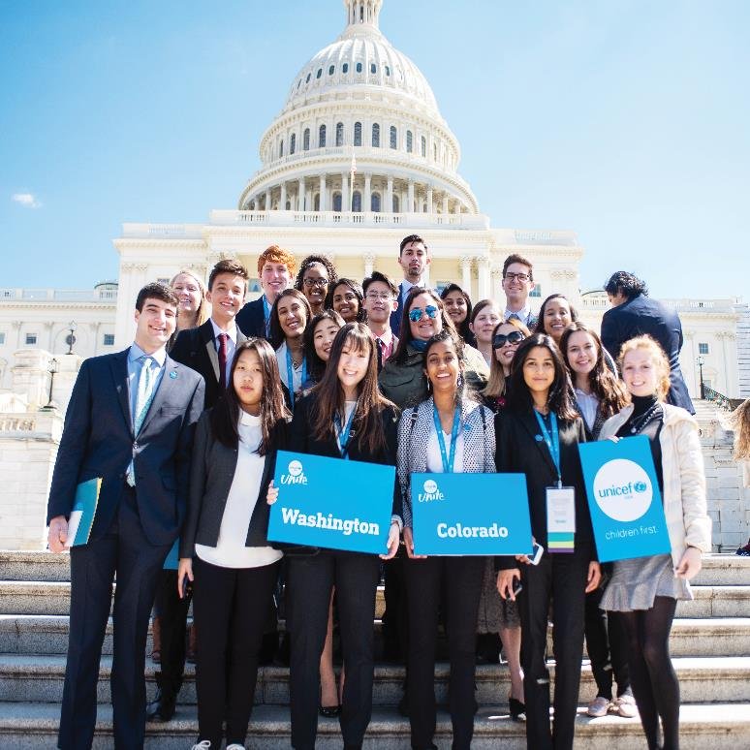
Interest Meeting
October 7, 2019

Slide 2
Agenda
> About UNICEF
> Previous Fundraisers
> Future Plans/ Events
> Official Membership
> Club T-Shirts

Slide 3
About Our Club
> A high school club that partners with the U.S. Fund called UNICEF (United Nations International Children’s Emergency Fund), which helps support child survival in more than 150 countries
> We engage in a variety of activities, including setting up various community activities to raise money to donate to UNICEF
> Becoming a member of an official UNICEF high school club is a great way to make an impact on UNICEF’s worldwide charitable work

Slide 4







health
wash
nutrition
UNICEF
PROGRAMS
education
child protection
HIV/AIDS
social inclusion

Slide 5












UNICEF Strategic Plan (2018 - 2021)
UNICEF works to realize the rights of every child –
especially the most disadvantaged
GOAL 1
Every child
survives
and thrives
Nutrition, maternal
and newborn care,
immunization and
preventable illnesses,
quality early childhood
development,
adolescent health,
HIV/AIDS
GOAL 2
Every child
learns
Children deprived
of school, gender
equality in education,
learning, skills
development
GOAL 3
Every child
protected from
violence and
exploitation
Violence against
children and other
harmful practices,
access to justice, grave
child rights violations
in armed conflicts, child migrants and refugees
GOAL 4
Every child
In a safe
and clean environment
Safe drinking water, sanitation, hygiene, open defecation, disaster response, children in urban settings, environmental sustainability
GOAL 5
Every child
has an equitable chance in life
Gender equality, adolescent empowerment, child poverty, child social protection systems, disability rights for children

Slide 6


UNICEF and UNICEF USA
> United Nations agency
> Human rights and development organization
> Advocates for children’s rights, help meets their basic
needs, expand opportunities to reach their fullest
potential, especially the most vulnerable
> Registered U.S. 501(c)(3)
> Non-profit organization / NGO
> Fundraise, advocate, educate in support of
UNICEF’s mission

Slide 7
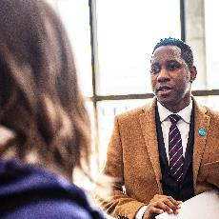
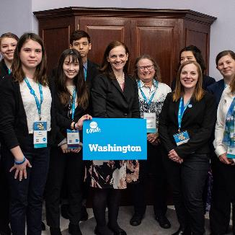
who are ?
UNITERs are UNICEF's front-line
advocates in the United States for
children everywhere.
UNITERs are UNICEF supporters and volunteers working to amplify children's voices and making real impact both
here and abroad.

Slide 8
Club Goals
Educate high schoolers about the problems that children face around the world
Every month we go over a different UNICEF monthly topic and find ways to volunteer in our own community to support these causes
Raise money to aid UNICEF in providing health, education, and human rights resources to underprivileged children
Organize events such as Chipotle night, information booths, coffee/hot chocolate sales, bake sales, and other events
  Members will be able to collect SSL Hours/ NHS Hours for each event.

Slide 9
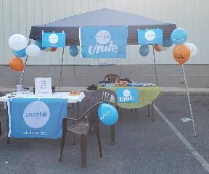

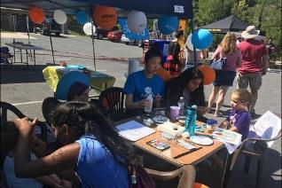
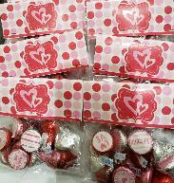

Past Fundraisers
Bake Sales
Poolesville Day Booth
Valentine’s Day Sale
Ice Cream Sales
Chipotle Night
Trick-Or-Treat for UNICEF
Donut Sales

Slide 10
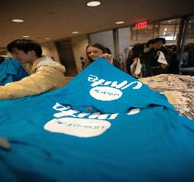
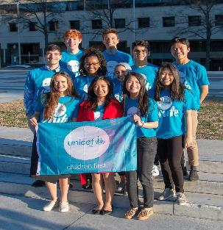
Upcoming Fundraisers
> Monthly Bake Sales
> Trick-Or-Treat for UNICEF
> Chipotle Night
> Henna Fundraiser
Note: Calendar with Dates will be given out next week

Slide 11
UNICEF Club Membership Application
ALL members must fill out an application, even if you’re a returning member
All forms are due by Monday(10/28/19) to Ms. Bowles
For new members : Go to, http://www.unicefusa.org, create an account and register
  Follow the instructions on the membership application
  Extra applications can be found on our website,
  https://poolesvilleunicef.weebly.com/how-to-join.html

Slide 12
Membership Dues (Cash or Check)
Dues are $10 for members
This money goes towards organizing UNICEF Club T-Shirts + events
  Checks should be payable Poolesville UNICEF
Attendance Requirement: Only allowed 5 unexcused meeting absences the entire year
Volunteer Hours Requirement: 5 UNICEF Volunteer Hours each semester
Members who meet volunteer and attendance guidelines will get UNICEF Certificate at the end of the year

Slide 13


Club T-Shirt Design Voting Form: Coming Out Soon In Groupchat

Slide 14
Next UNICEF Club Meeting: Monday, October 14th
This presentation can be found under the “Meeting Updates” tab on our website

Slide 15
Contact Us
Email: poolesvilleunicefclub@gmail.com
Instagram: @poolesville.unicef
Website: http://poolesvilleunicef.weebly.com
Take a picture of this slide!!!

Slide 16
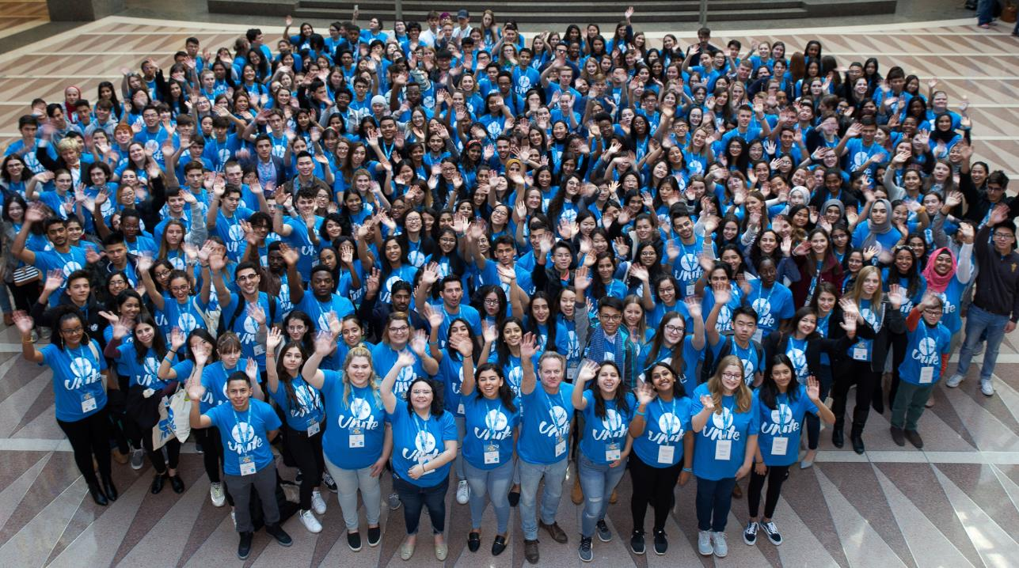
QUESTIONS? Email: poolesvilleunicefclub@gmail.com

