Slide 1

Girl’s Education Meeting
October 14, 2019

Slide 2
Membership Dues (Cash or Check)
Dues are $10 for members
This money goes towards organizing UNICEF Club T-Shirts
  Checks should be payable Poolesville UNICEF
Attendance Requirement: Only allowed 5 unexcused meeting absences the entire year
Volunteer Hours Requirement: 5 UNICEF Volunteer Hours each semester
Members who meet volunteer and attendance guidelines will get UNICEF Certificate at the end of the year

Slide 3
UNICEF Club Membership Application
ALL members must fill out an application, even if you’re a returning member
All forms are due by Monday(10/28/19)
Optional: For new members : Go to, http://www.unicefusa.org, create an account and register
  Follow the instructions on the membership application
  Extra applications can be found on our website,
  https://poolesvilleunicef.weebly.com/how-to-join.html

Slide 4





Club T-Shirt Design Voting: In Groupchat- ends this Wednesday

Slide 5

International Day of the Girl
When: October 11, 2019
What is it: People worldwide celebrate this day to fight against the neglect and devaluation of girls.
https://www.youtube.com/watch?v=ZyCj6g0vOxA

Slide 6
Issues Girls Face Today
54% of 3rd -5th grade girls worry about their appearance and 37% worry about their weight.
By 2015, females will make up 64% of the world’s illiterate (adult) population.
Only 30% of girls in the world are enrolled in secondary school.
One in seven girls in developing countries is married off before age 15.

Slide 7
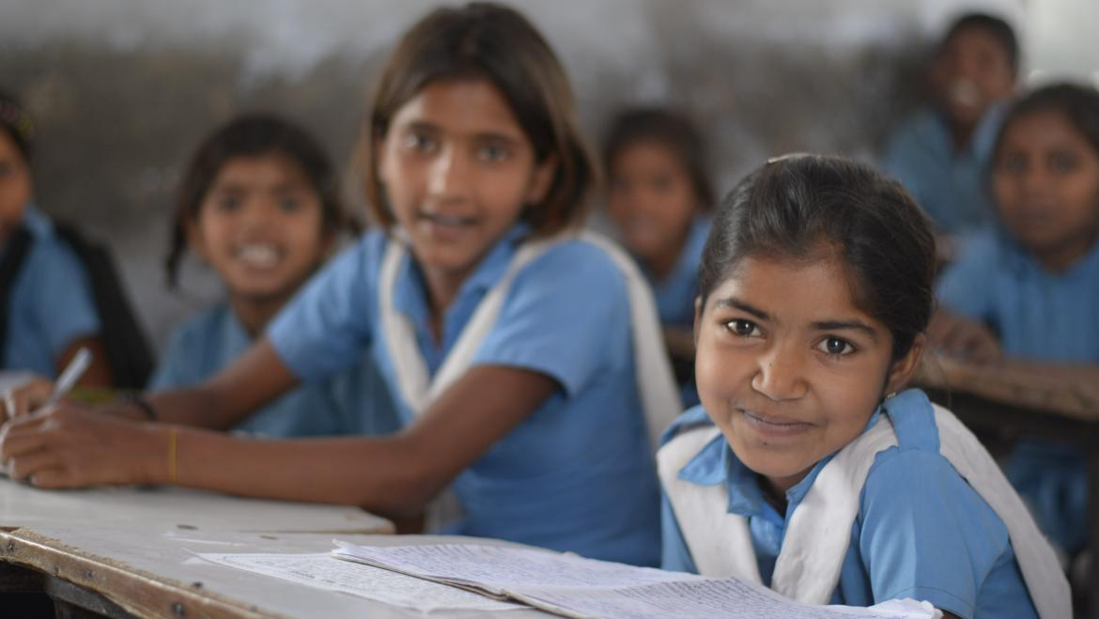
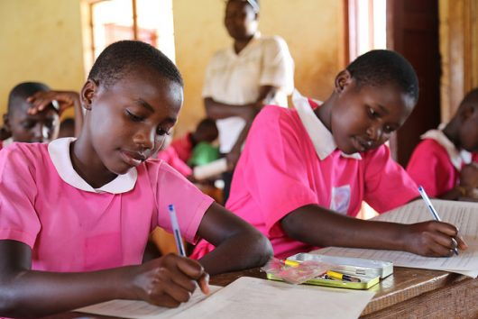
Importance of Education
Education helps a girl to respect herself and to be respected by others.
Education drastically reduces child marriage. On average, a girl with 7 years of education will marry 4 years later and have 2.2 fewer children.
Education is essential for a strong economy. One extra year of school boosts a girl’s future wages by 10-20 percent.
Education fosters critical thinking skills, which are essential for effective leaders and democracy. More women are needed to solve global problems.

Slide 8
Keeping Girls in School Act
• Emphasizes the importance of secondary education for girls and highlighting the need to bridge the gap in education between primary and secondary levels for adolescent girls.
• Stresses the importance of both access to and quality of education for girls by looking at girls' lives holistically, with attention to rights, quality of education, health, safety, and harmful practices.
• Leverages innovative financing mechanisms to build broader and stronger partnerships globally to promote girls’ access to education and continued learning
• Contributes to efforts to fight poverty and advance America's national security interests by promoting opportunities that could lead to more stability abroad.

Slide 9
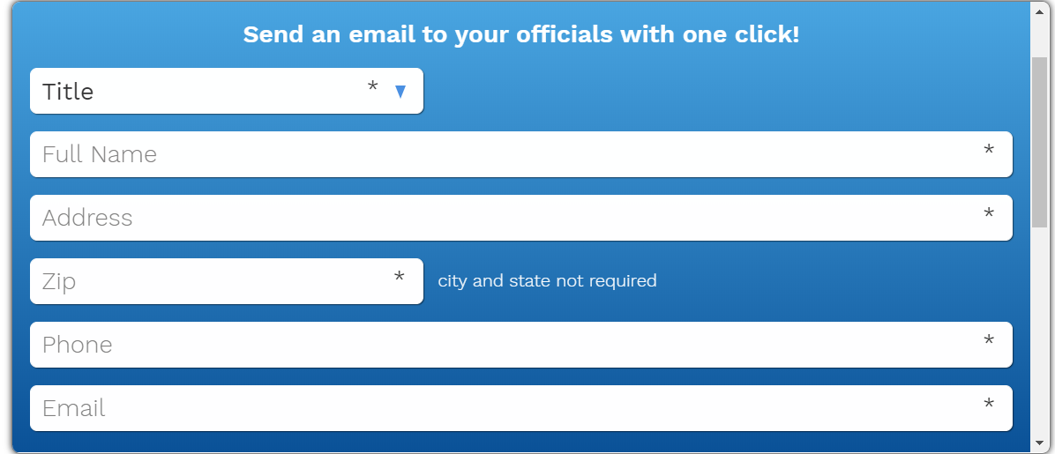
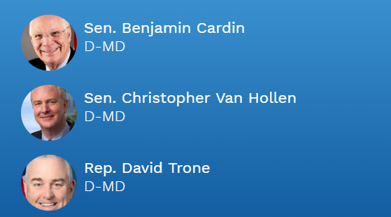
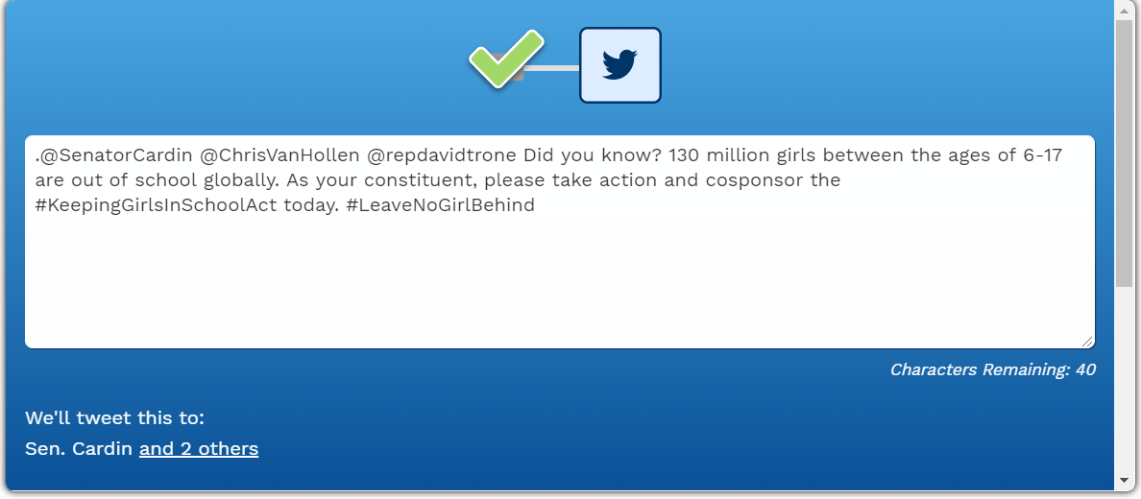
How You Can Help
https://www.unicefusa.org/help/advocate/urge-congress-keep-girls-school
Send an email and/or tweet to MD Senators and Representative about the Keeping Girls in School Act
Write a letter to a MD Senator or Representative about the Keeping Girls in School Act

Slide 10
Important Features of Letter
The Honorable Senator Cardin
United State Senate
Washington, DC 20510
Dear Senator Cardin:
Sincerely,
Your name,
Address
Phone Number
E-mail Address

Slide 11
Next UNICEF Club Meeting: Monday, October 21st
This presentation can be found under the “Meeting Updates” tab on our website

Slide 12
Contact Us
Email: poolesvilleunicefclub@gmail.com
Instagram: @poolesville.unicef
Website: http://poolesvilleunicef.weebly.com
Take a picture of this slide!!!

Slide 13
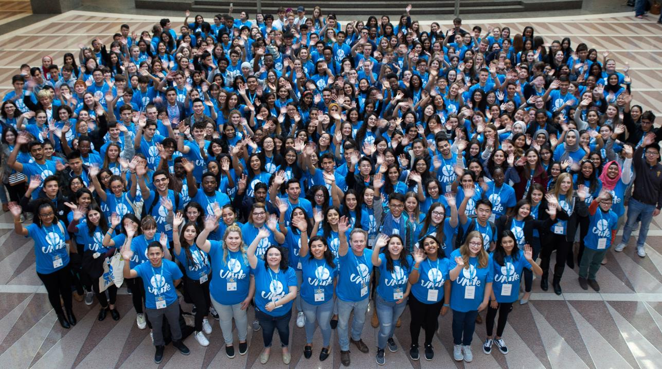
QUESTIONS? Email: poolesvilleunicefclub@gmail.com

